Slide 1
Working Together to Support Reading Progress.

Slide 2


Reading
If you can encourage your child to read they will really reap the benefits.
Research shows that reading can be directly linked to children’s success throughout their time at school and even into adulthood.

Slide 3
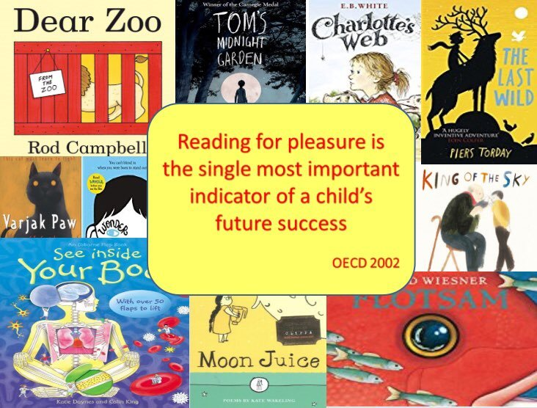

Slide 4
Home reading
Between 36% and 70% of children read regularly at home.

Slide 5


Slide 6

1. Emotional Wellbeing
Research from the National Literacy Trust has shown us that children and young people who like to read are three times more likely to have better mental health than those who don’t.
Reading for just 10 minutes a day can have astonishing benefits. Not only is it a brilliant way to relax and unwind, reading can also help boost your mood, provide an escape from the pressures of life and even reduce stress levels.
There are so many books and stories that allow children to explore their internal world and make sense of difficult emotions such as sadness, anger and anxiety.

Slide 7

2. Social Skills
Reading has social benefits and can make people feel more connected to the wider community.
Reading increases a person’s understanding of their own identity, improves empathy and gives them an insight into the world view of others (The Reading Agency 2015).

Slide 8

3. Creative Thinking
Whenever your child reads a book, they have to look at a piece of paper, take in the words on the page, and construct an imaginary universe in their mind, featuring the characters about whom they are reading.
It’s this mental engagement which is so valuable – it’s about being active, rather than just passively absorbing content from a screen. Reading is a real work-out for the mind, encouraging lots of parts of the brain to engage – much more than passive screen gazing.

Slide 9

4. An opportunity for cross-curricular learning
Reading gives your child a huge amount of cross-curricular learning without it feeling like they’re learning.
Getting their noses into a book lets them learn about history, science, geography and much more.

Slide 10


5. Children who read are the best writers
Good reading leads to good writing. If your child regularly encounters rich vocabulary, a range of sentence structures and a variety of punctuation, they will find it easier to write using these themselves.

Slide 11

Supporting Readers at Home
Open University research suggests there are three important ways to support readers and a love of reading.
1. Reading aloud to your children shows them reading is a pleasure, not a chore. Older children can read to younger ones too.

Slide 12


2. Family Reading Time.
Making time to read alongside one another helps develop children’s reading stamina and interest. Let them see that reading for pleasure is not just for children! Let them choose what to read and relax together. If nothing else, it will mean less time on those devices!!!

Slide 13
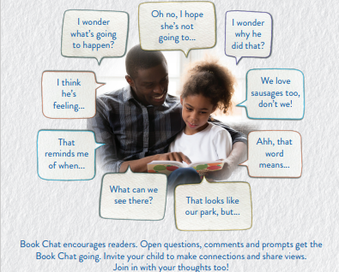

Slide 14
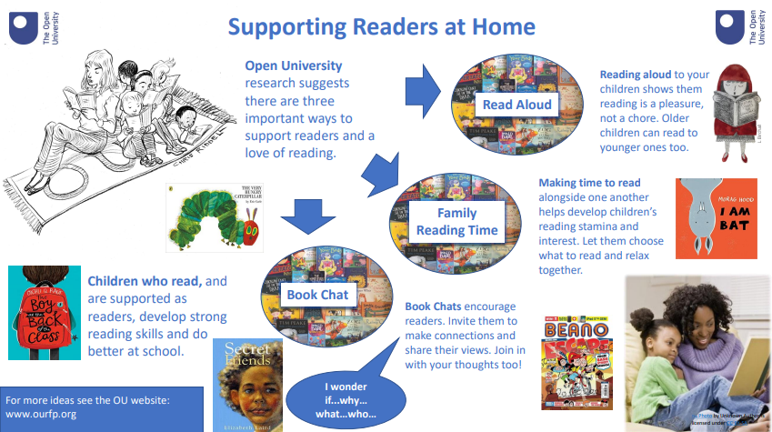

Slide 15

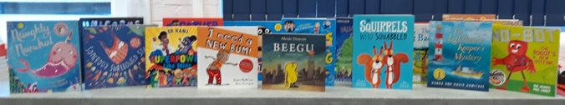
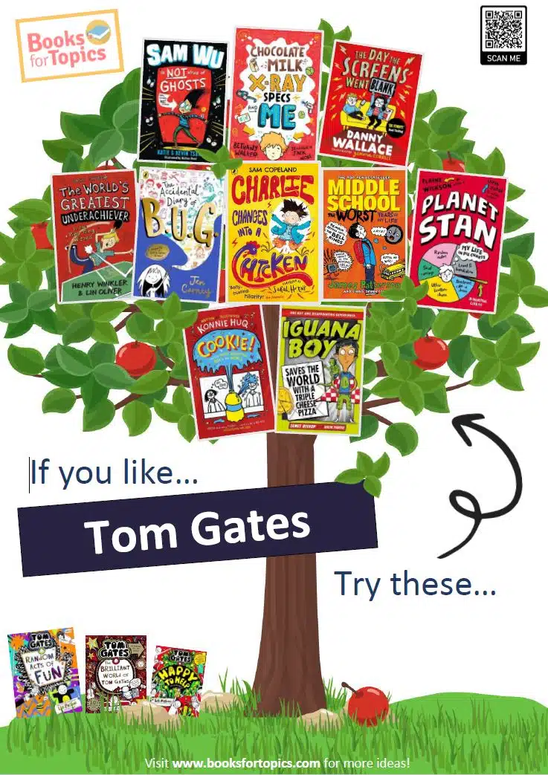
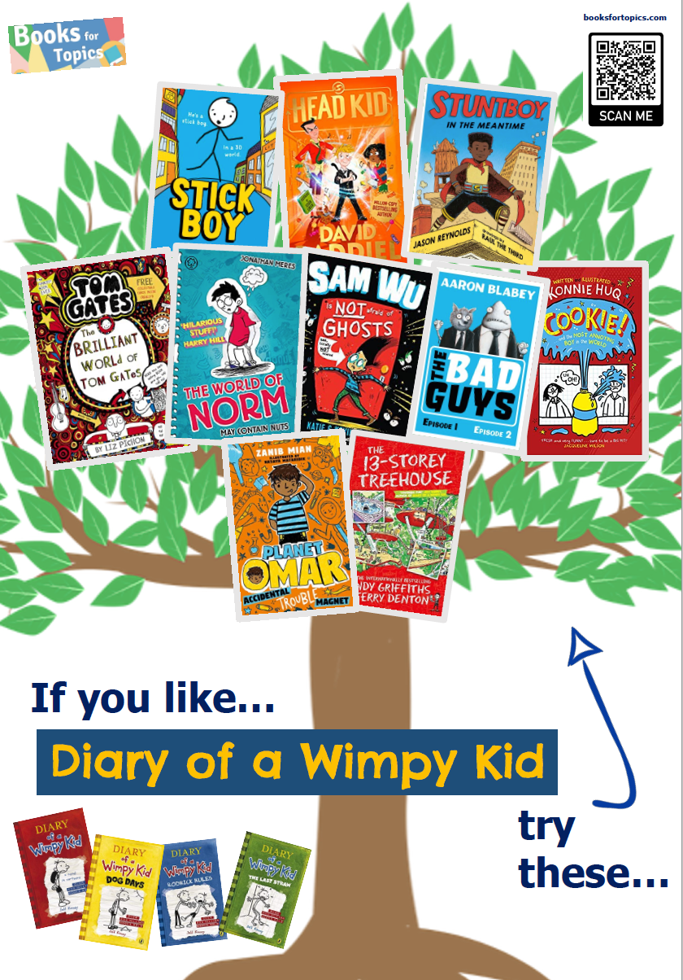
Book Tasting
Cover – Title, Author, Quotes
Blurb
Inside pages
Pictures
What do you like? Why?
Which do you prefer?

Slide 16
Vocabulary

Slide 17
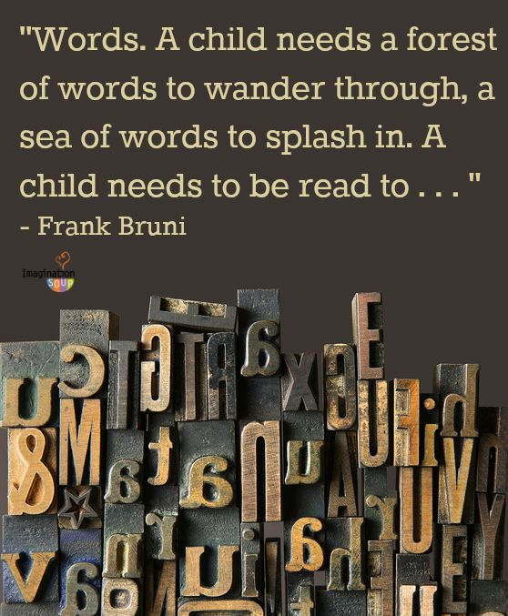

Slide 18
Building vocabulary from EYFS to KS2
The number of words you know and can use confidently and appropriately has a direct impact on your success as a reader, as well as your ability to express and communicate your ideas to others.
GCSE performance can be predicted from the size of children’s working vocabulary as they start school.

Slide 19
Starting school
The average working vocabulary of
a reasonably well performing child.
The average working vocabulary of a poorly performing child starting school
7,100
3,000

Slide 20

How many words children will have heard by the time they are five years old
• Never read to: 4662 words
• 1 – 2 times a week: 63,570 words
• 3 – 5 times a week: 169,520 words
• Daily: 296,660 words
• 5 books a day: 1,483,330 words
Science Daily (2019), quoted in the Reading Framework

Slide 21
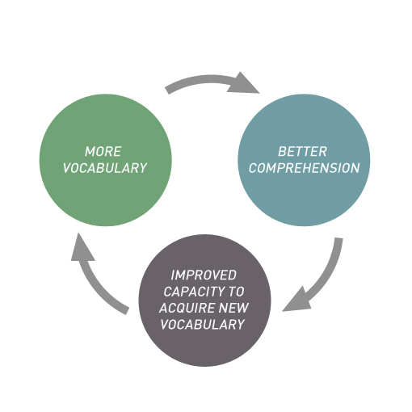
Good vocabulary
helps children gain ownership of words (being able to use or think about a word in a variety of different ways).
provides meaningful information because comprehension is improved.
involves children more actively in word learning.

Slide 22
Teach a new word
Introduce the new word and highlight its features:
• Pronunciation
• Meaning
• Example
• Explanation
• Interesting features
• Identify word part (morphemes)
Discuss some or all of these elements
• Context it would be used in
• Synonyms, relatives and relationships
• Antonyms
• Word functions - grammar
• Etymology
• Dictionary

Slide 23
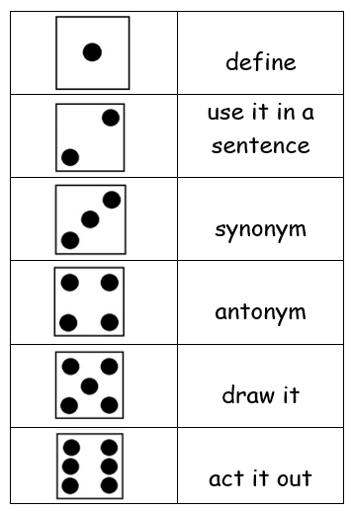
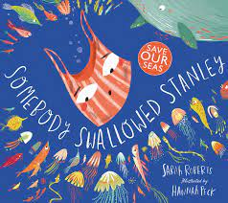
ordinary
terrible
rough
burst
scruffy
stuck
https://wheeldecide.com/index.php?c1=Synonym&c2=Antonym&c3=Meaning&c4=Example&time=5
Antonym: a word opposite in meaning to another (e.g. bad and good ).
"the antonym of ‘inclusion’ is ‘exclusion’"
Synonym: a word or phrase that means the same as another word or phrase in the same language, for example shut is a synonym of close.

Slide 24
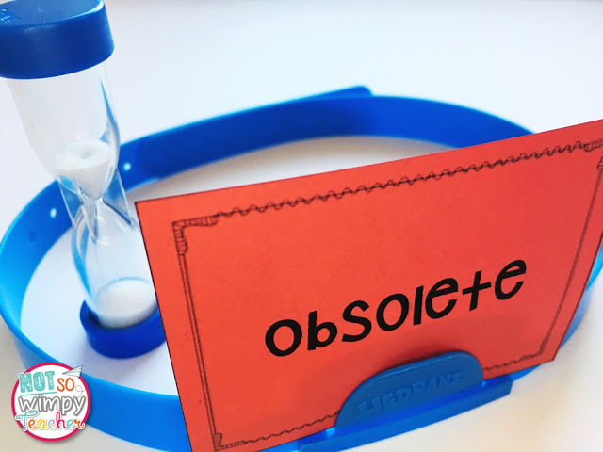
Headbandz
Pick a card and do not look at it
Put it on your headband / stick to head on a post it
Ask yes or no questions to the rest of the group
Is my word a verb?
Does my word start with a vowel?
Is unfashionable a synonym?

Slide 25
Talking and reflecting
Build reflection on language use – specifically
on vocabulary learning – into as many reading/
talking opportunities as possible.
EG:
What new words did we learn?
What did they mean? How did we use them?
What did we find surprising?
What will help us remember them?
What synonym did we learn to use instead of …?
What was the difference between shrieked and
yelled? When would we use which?

Slide 26
Improving Reading Fluency
Why is fluency important?
What is fluency?
How can fluency be improved?
Ideas to ensure fluency.

Slide 27
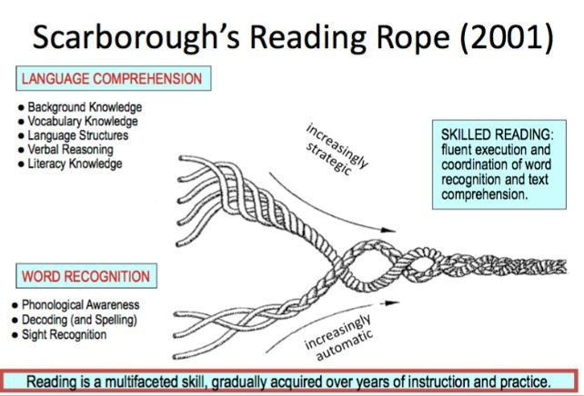

Slide 28
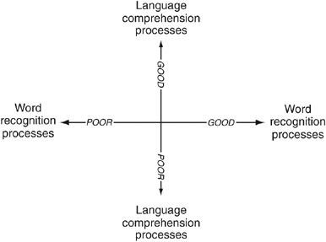

Slide 29
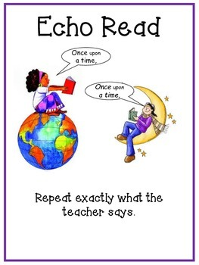

Slide 30
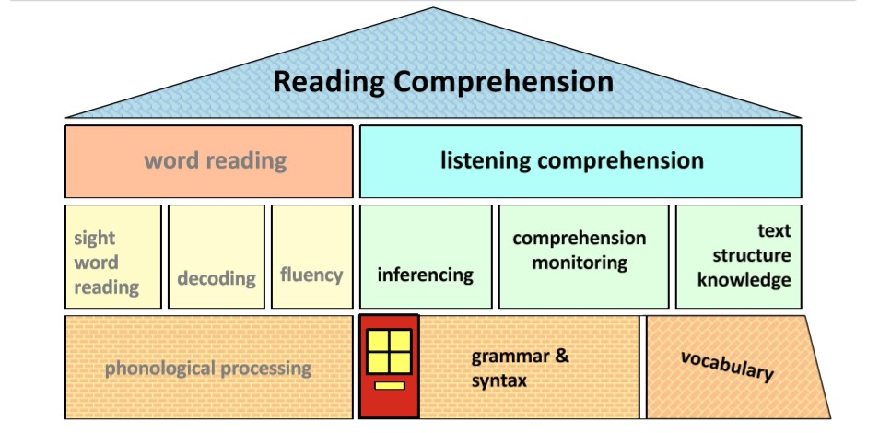

Slide 31
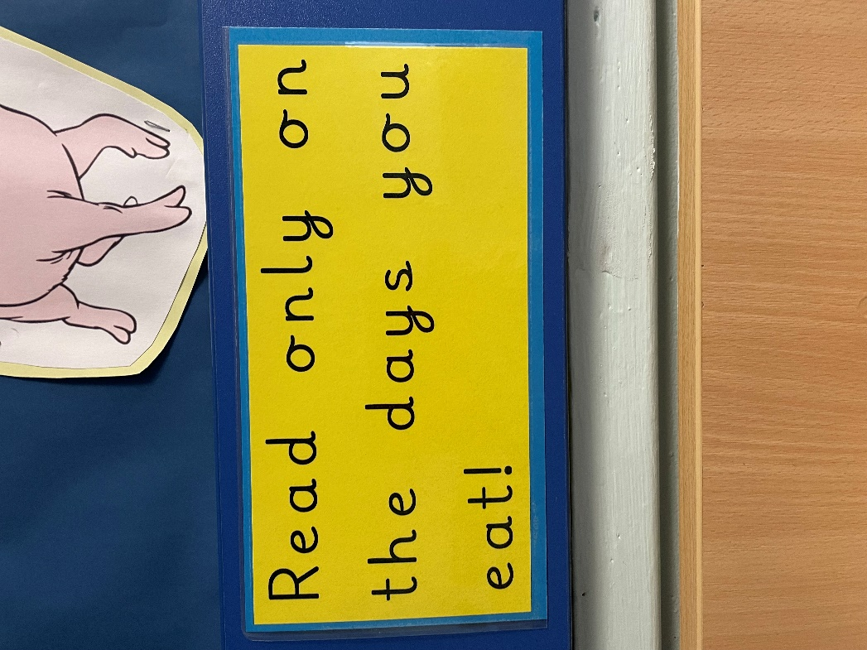

Slide 32
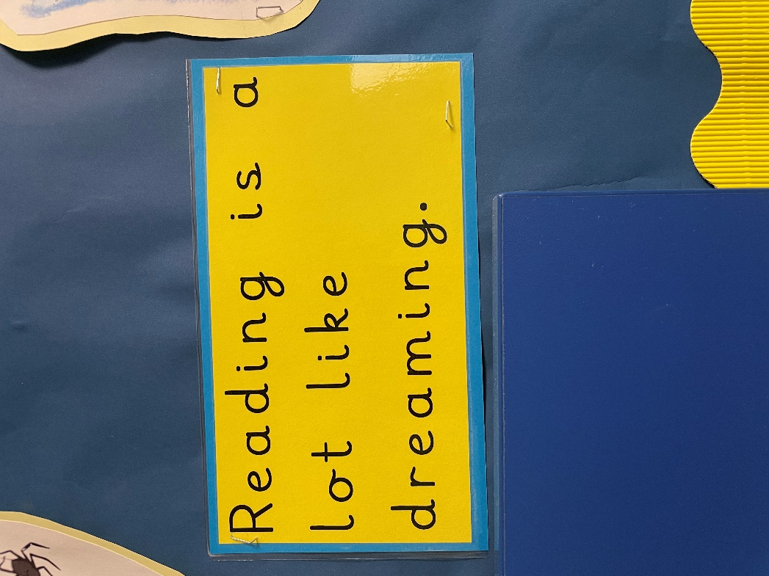

Slide 33
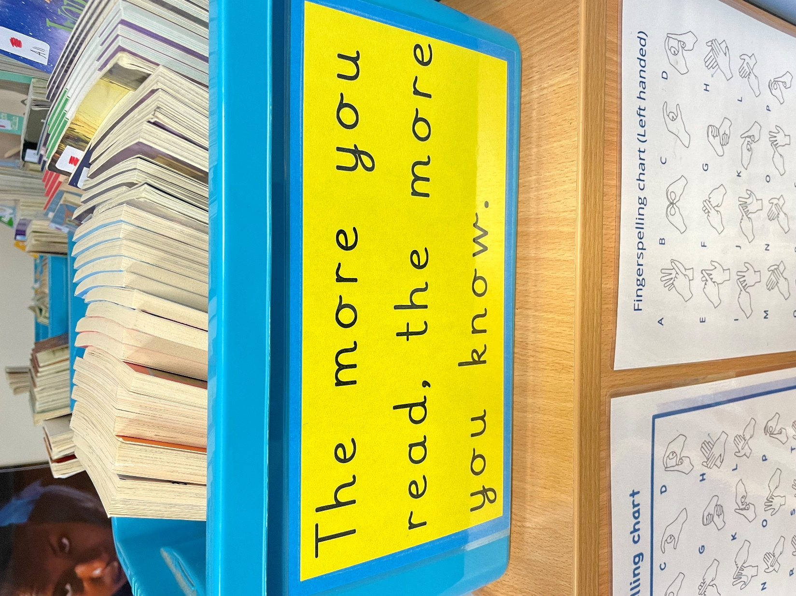

Slide 34


Slide 35
Video:
https://www.youtube.com/watch?v=g4Nf0Hcuv4Y

Slide 36
Thank you so much for attending.
Please remember to take your Christmas present idea that will last all year!

