Slide 1




Starting in Reception September 2026
Harvington C of E First and Nursery School

Slide 2


Welcome
We know that starting school is a major step for both you and your child. We therefore aim to make the transition from home or nursery as smooth and as pleasant as possible. Our first priority is to provide a happy and secure atmosphere where their individual needs and potentials are recognised.
This PowerPoint provides you with valuable information and steps you can make to help your child ready for life at school.

Slide 3

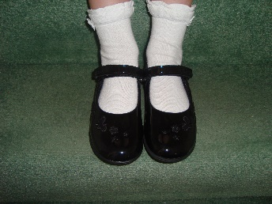



Encourage your child to use independence so they can do they following:
Put on and take off their own shoes (avoid laces!)
Use the toilet independently including flushing and washing their hands afterwards
Use a knife and fork
Dress and undress ready for PE and fold and stack their clothes
Tidy toys away after use
Play with other children and know how to share possessions
Wipe their nose
Zip or button their coat
Carry their own school bag

Slide 4


It would be great if your child….
Has the confidence to talk to adults and other children
Knows how to ask for help if they need it
Isn't afraid to have a go and is not afraid to make mistakes
Can listen to and follow simple instructions
Uses kind manners saying please and thank you
Can find ways to comfort themselves as we cannot allow comfort toys or dummies

Slide 5


How to support your child with early reading
Try to share a book with your child each day.
Encourage your child to choose a book of their choice and don’t worry if they often make the same choice, it is important that they stay interested!!
Take time to talk about the pictures, asking questions.
Help your child know how books work – They start at the front, they are read page to page to the back, words are read from left to right, it’s easier to follow the words with you finger as you read out loud.
Help your child to recognise their own name so they can find their coat hook, clothing and tray etc.
Remember all experiences with books should be enjoyable

Slide 6



How you can help your child with early writing
Encourage and praise any mark making as this will boost your child's love for writing
Make marks in many different ways, pencils and pens on paper, sticks in sand or soil, paint brush and water on the patio etc.
Have many different materials available to them, pencils, pens, chalks, crayons and brushes
Let them see other family member writing, this can be shopping lists, birthday cards or letters. Let them have a go too.
Introduce them to the letters in their name

Slide 7



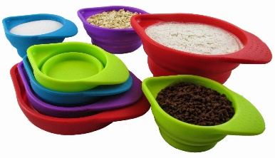

Maths is everywhere. Routines and the environment all offer rich resources of mathematical experiences for your children. Doing these everyday things will help support your child:
Read number books together
Try to use correct language – more, less, short, long, heavy, light
Read numbers on houses and cars
Point out colours and talk about them
Sing and say number rhymes
Sort the washing, match socks
Play dominoes/snap/board games
Measure ingredients by making cakes
Predict –do you think it will rain today? Will all of those toys fit in the box?
Make patterns – threading beads, alternate coloured bricks.

Slide 8



Children need lots of practise to develop physical skills. You can help support your child in the following ways:
Hold a pencil correctly which is between the thumb and forefinger supported by the middle finger
Colour between the lines
Do lots of cutting, along straight lines, curved lines and shapes
Catch, throw and kick balls
Use construction kits such as Lego, Duplo, stickle bricks and Hama Beads etc
Practise balance on scooters and balance bikes
Be creative, making things out of boxes, toilet rolls, bottle tops etc.
Complete lots of jigsaw puzzles together

Slide 9

Watch them flourish!
Please don’t worry if your child can’t do everything that has been mentioned. Every child is different and they all do things at different stages. We are here to help support them with all areas of their learning. Please contact Mrs McCaugherty (Home School Link) if you have any concerns or questions about your child starting school.
schoollink@Harvington.worcs.sch.uk

