Slide 1

Welcome to Year R!
Class teachers: Mrs Poole (Monday, Tuesday and Wednesday) and Mrs Enstone (Thursday and Friday)
Teaching Assistant: Mrs Prosser (Monday-Friday)

Slide 2
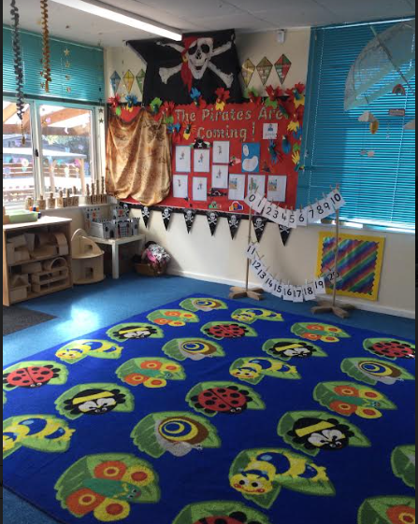
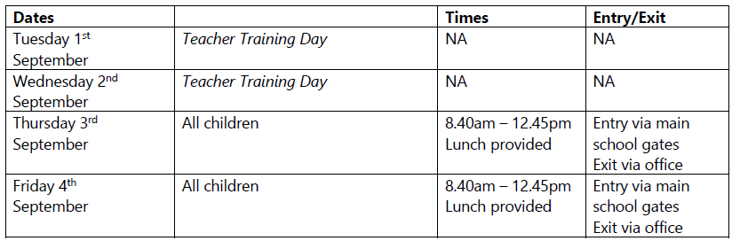
The first week of school:

Slide 3
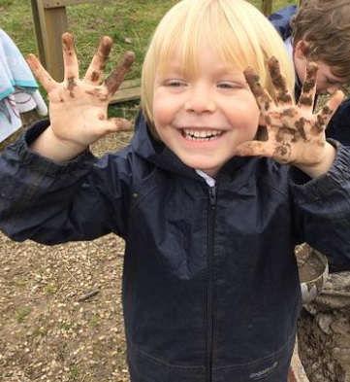
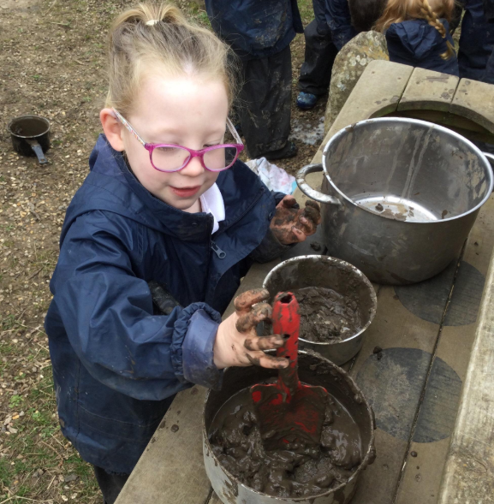
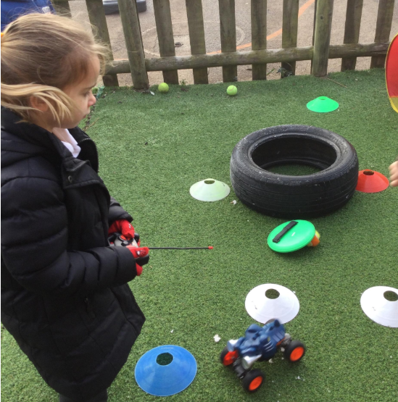
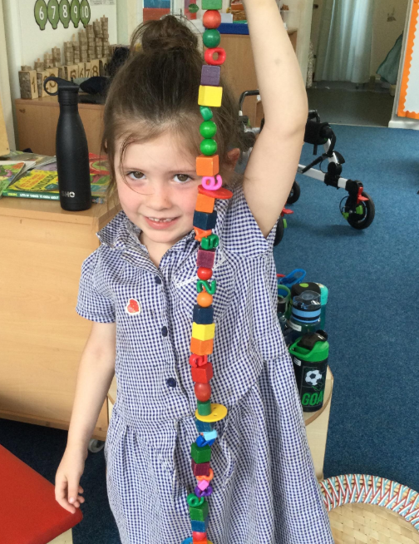
A typical day…
Arrival-register and lunch orders
Collective Worship
Phonics
Snack time
Drawing Club
Lunch
Maths
Theme
Home time
Continuous provision

Slide 4
What does my child need? | What doesn’t my child need?
Named uniform and coat Named PE kit Named wellies Named water bottle Named lunch box and plate if having packed lunch Sunhat Message book | Stationery Toys-including keyrings on book bags Books Sweets Blankets/comforters Morning snack-we provide fruit for all children and milk for under 5’s. We will provide a book bag-children do not need any other bags apart from their PE kit

Slide 5
Early Years Curriculum
Prime | Specific
Communication and Language: Listening, attention and understanding Speaking Physical development: Gross motor skills Fine motor skills Personal, Social and Emotional development: Self-regulation Managing self Building relationships | Literacy: Comprehension Word reading Writing Mathematics: Number Numerical patterns Understanding the World: Past and Present People, Culture and Communities The Natural World Expressive Arts and Design: Creating with materials Being imaginative and expressive
Prime and specific areas of learning
Seven areas of learning

Slide 6
Our Half Termly Themes
Autumn 1 | Autumn 2 | Spring 1 | Spring 2 | Summer 1 | Summer 2
Me in My World | My World | Houses and Homes | Food | Express Yourself | All Creatures Great and Small

Slide 7
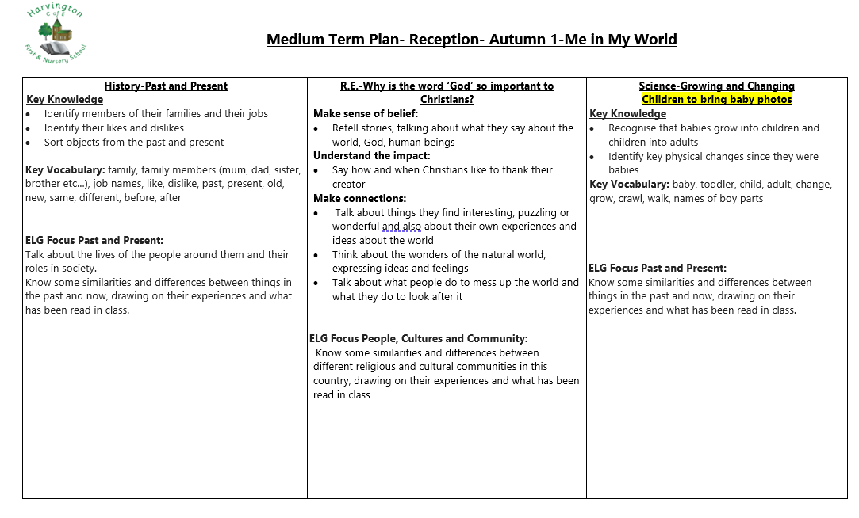

Slide 8
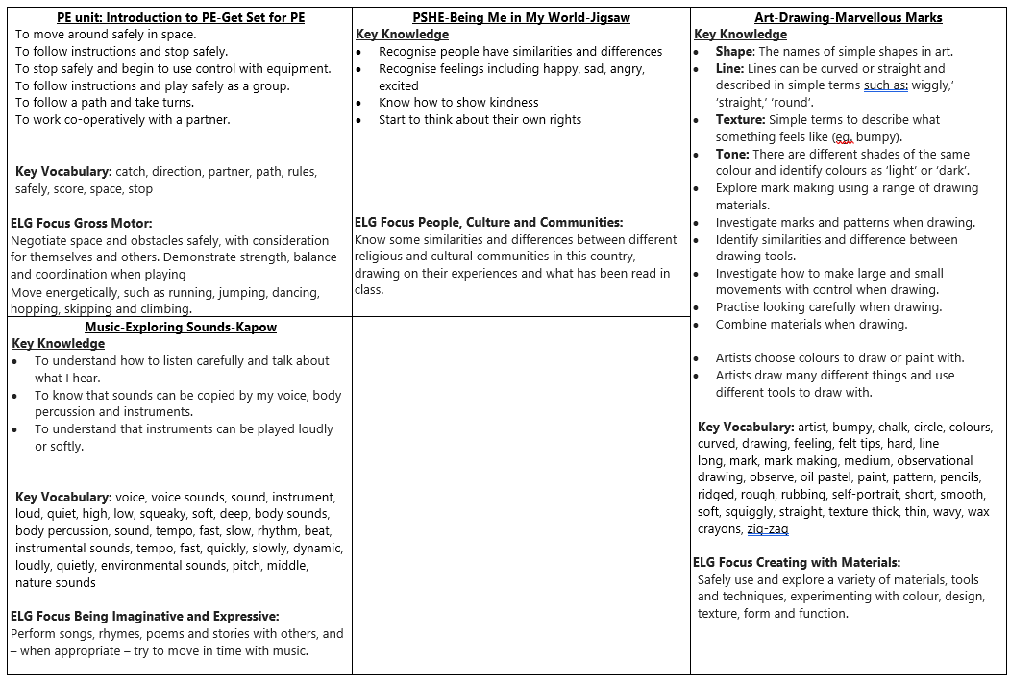

Slide 9

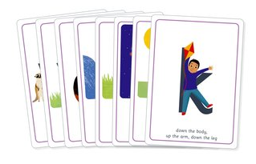
Phonics
Phonics is a way of teaching children how to read and write. It helps children hear, identify and use different sounds that distinguish one word from another in the English language.
Written language can be compared to a code, so knowing the sounds of individual letters and how those letters sound when they’re combined will help children decode words as they read.
Understanding phonics will also help children know which letters to use when they are writing words.
We use the ‘Essential Letters and Sounds’ scheme.
We practise phonic skills everyday in school and reading books sent home are matched to the phonics sounds covered in class.
Please see the website for videos about sound pronunciation.

Slide 10
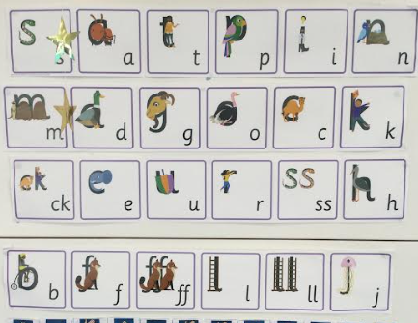

ELS Phonics
How can I help my child?
To best support your child when they are learning to read, we suggest that you read the decodable text provided by the school 4 times across the week. Spending 10 minutes a day reading with your child will hugely support them in their journey to becoming an independent reader.
Another key way to support your child is to read to them too! Share exciting and engaging books and stories with them.
It is a key part of learning to read that children re-read words and sentences that they can decode (sound out) until they are fluent (read with ease and precision). By reading texts several times children have the greatest opportunity to achieve this fluency.
The texts sent home by your child’s school are carefully matched to the teaching taking place. Your child will be practising what they have been taught in school with you at home. Your child should be able to decode and read their phonics book independently, though they may need some support with blending at the beginning of their reading journey. There will be some words that are not decodable, we call these ‘harder to read and spell’, you can help your child with these words when they are reading. Reading Workshop Wednesday 23rd September at 2:15pm

Slide 11
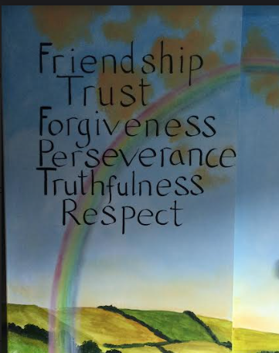
Our School Values
We are a church school, Our Visions and Values are at the core of everything we do. They underpin our teaching and learning and provide an environment that prepares our children to be confident, respectful, happy and well prepared for their next steps.
Our School vision:
Together we love, learn and grow.
We follow these passages from the Bible:
Love
Matthew 22:39
‘Love your neighbour as yourself’
Learn
Proverbs 2:2
‘Turn your ear to wisdom and apply your heart to understanding’
Grow
Peter 3:18
‘Grow in the grace and knowledge of our Lord’

Slide 12
Our School Values
Our Six Core Values are:
Truthfulness - We always tell the truth and earn the trust of one another.
Perseverance - We are happy to learn from our mistakes and never give up.
Friendship - We understand that a good friend can be trusted and is loyal.
Trust - We understand that we need to trust others when working together as a team.
Forgiveness - We are able to forgive others and accept that we all make mistakes.
Respect - We appreciate the importance of respecting everyone and everything

Slide 13
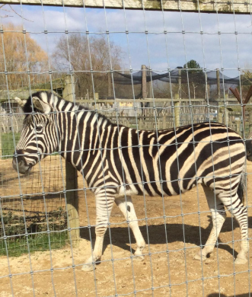
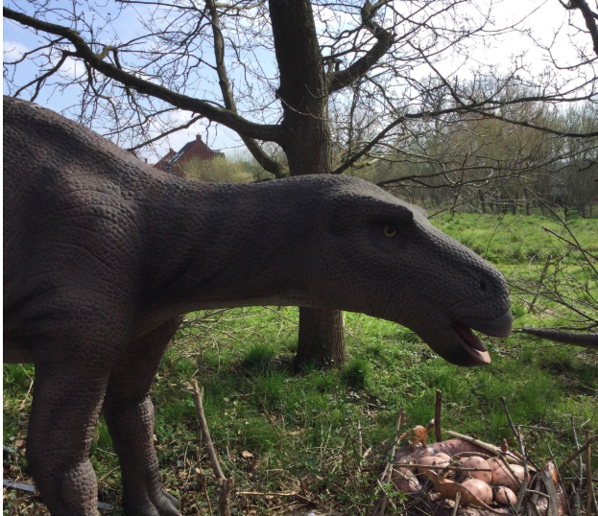
Events/Themes throughout the year
School trips
Visitors
Together days with Nursery
Whole school events such as Harvest, Nativity..
Sports day
Parent meetings
Celebration assembly

Slide 14
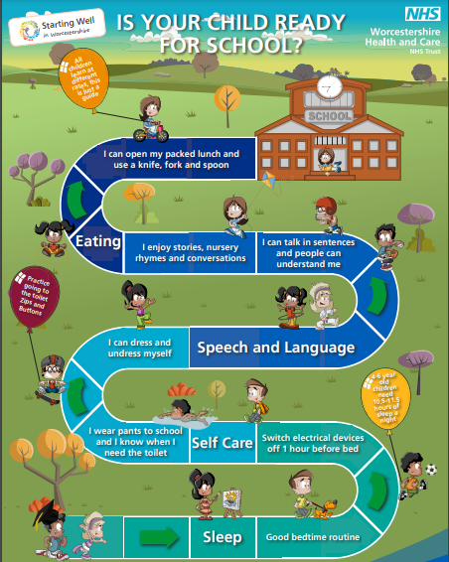

How can I support my child to be ‘Reception ready’?
These links have some really useful information: https://www.worcestershire.gov.uk/readyforschool https://startingreception.co.uk/

Slide 15
PTFA-Parents, Teachers and Friends Association
We are made up of parents, teachers and friends of the school.
When your child starts Nursery or School, you automatically become part of the PTFA.
The PTFA is volunteer led and we very much believe that ‘more the merrier and many hands make light work’.
Our aim is to raise funds to provide the best opportunities and experiences for the children.
The PTFA have funded: school trips, ising pop, Christmas presents, forest school waterproofs as well as many other resources.

Slide 16
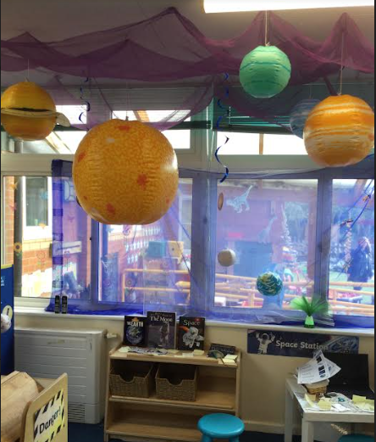
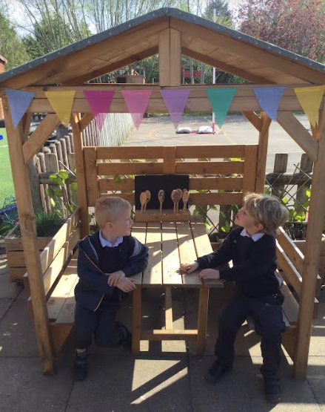
Sharing Remarkable Learning Moments on Class Dojo
We use class dojo to communicate with parents.
We have a main class page where we will post general information.
Each child will also have their own page where we upload a remarkable learning moment each week so you can see what your child has been learning-this page is private to you.
We would encourage you to share things from home as well as the children enjoy sharing their photos with the other children.

Slide 17
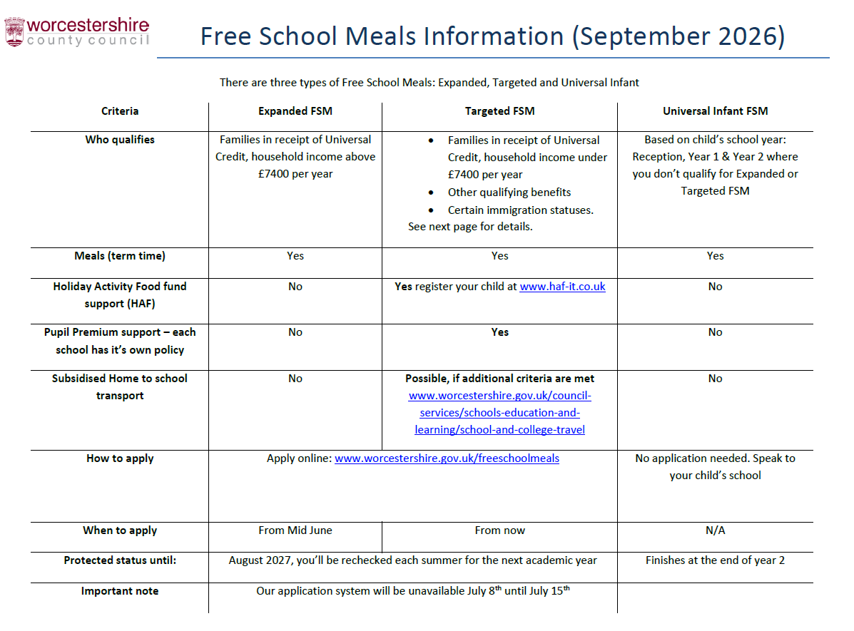
Universal Free School Meals and Expanded Free School Meals

Slide 18
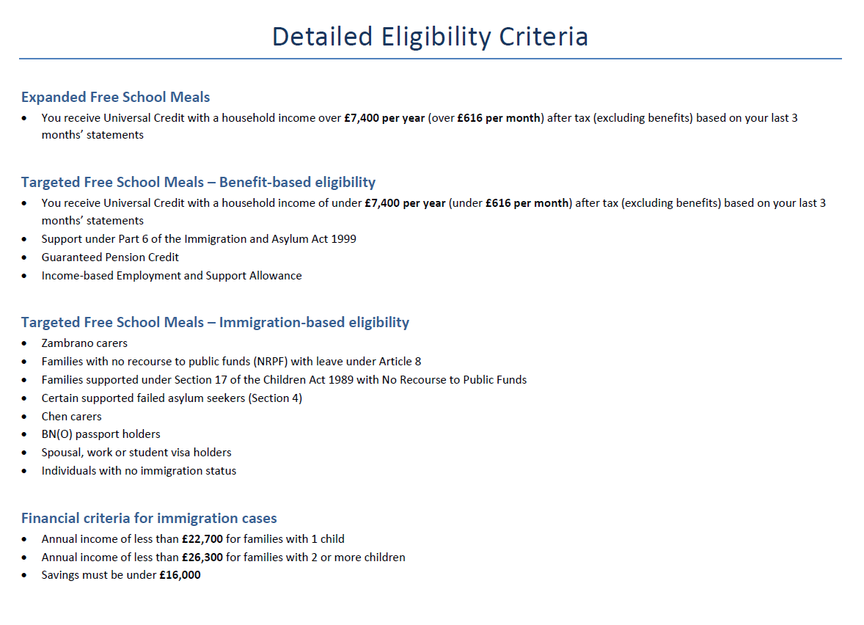

Slide 19

Thank you and we look forward to working with you!

