Slide 1


Starting Nursery in September 2026
Harvington C of E First and Nursery School

Slide 2

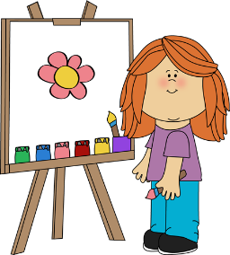


Welcome to Harvington C of E First and Nursery
School
Starting nursery is a big step for you and your child and for many it’s the first time that your child has had any time away from their family. At Harvington we will do all that we can to make this transition is as smooth as possible. The highly skilled and experienced nursery team are here to support your child and will introduce them to lots of new and fun experiences.
This Power Point will help you prepare your child for their new adventure!

Slide 3


Every child is unique and they learn at different rates but it would be an advantage if you can help prepare your child so they can settle into nursery as quickly as possible.
The following slides provide you with advice which will help your child in many areas of their development.

Slide 4


Personal, Social and Emotional Development.
We will support your child to:
Say goodbye to the person bringing them to nursery without getting upset
Ask an adult if they need help with something
Take an interest in other children when they are playing and join in with them
Share toys and take turns when directed by an adult
Know how to comfort themselves without the use of comfort toys or dummies

Slide 5


Communication and Language (Speaking and listening)
We will support your child to:
Sit and listen to stories
Join in with familiar stories and songs
Is able to follow simple instructions such as “put your coat on”
Is able to understand simple questions involving words like ‘who’ ‘what’ and ‘where’
Speak in simple sentences using at least 3 words
Can recount things that have happened

Slide 6


Physical Development
We will support your child to:
Put their own coat on with adult support
Can pull their own socks and shoes on
Say when they need the toilet and use the toilet with some independence
Wash and dry their hands by themselves
Hold a pencil/crayon/paintbrush and is beginning to make marks on paper
Hold a pair of scissors and can make little snips on paper

Slide 7
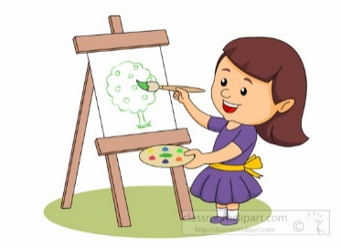

Understanding the world and being creative
We will support your child to:
Explore different kinds of ways of being creative such as painting, sticking and drawing
Join in activities such as singing, dancing and playing instruments
Notice things in the world around them and ask questions about why things happen
Talk about their family and friends and talk about things that have happened in the past

Slide 8


Playing, Exploring and Active Learning
We will support your child to:
Show curiosity about events, objects and people
Take risks and explore through trial and error, showing perseverance but change what they are doing if something isn’t working
Think of their own ideas to solve problems
Use their senses to explore the world around them
Use their own experiences when role playing
Is proud of themselves when they have worked hard at something

Slide 9


Reading and writing
In nursery we introduce reading and writing by:
Singing songs and nursery rhymes
Reading stories to the children and asking them to join in using repetition
Talking about books including the pictures
Drawing pictures of themselves

Slide 10



Maths
We introduce mathematics to the children through:
Saying numbers in the correct order
Asking question such as “how many” and by using keywords such as more/less
Talking about shapes and encouraging the children to recognise them
Talking about colours and encouraging the children to recognise them
Number rhymes and songs

Slide 11
Finally…..
We understand that you may have many questions or anxieties about your child starting nursery. The team at Harvington are here to support you. If you need to speak to someone about any concerns you may have please call the school office or you can email our Home School Link, Mrs Sally McCaugherty.
schoollink@harvington.worcs.sch.uk
We look forward to seeing you soon!

