Slide 1
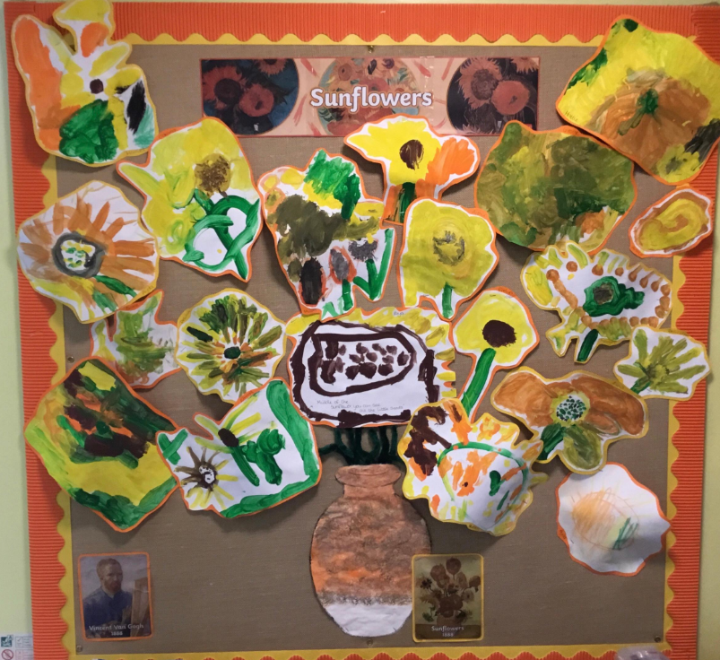
Welcome to Harvington C of E First and Nursery School
Becky Enstone (Early Years Lead)
Anita Wood (Nursery Manager)
Emma Suffield (Deputy Manager)
Keyworkers: Anita Wood, Emma Suffield,
Amy Stone, Bryony Reeve

Slide 2
Nursery times
Flexible provision
Can include Early Birds (8.00-8.40am) and Wrappers session (3-6pm)
Morning session (8.40-11.50am)
Morning session with lunch (8.40am-1pm)
Afternoon session (11.50am-3pm)
All day (8.40am-3pm)
Afternoon collection from 2.50pm to help those collecting school aged children

Slide 3
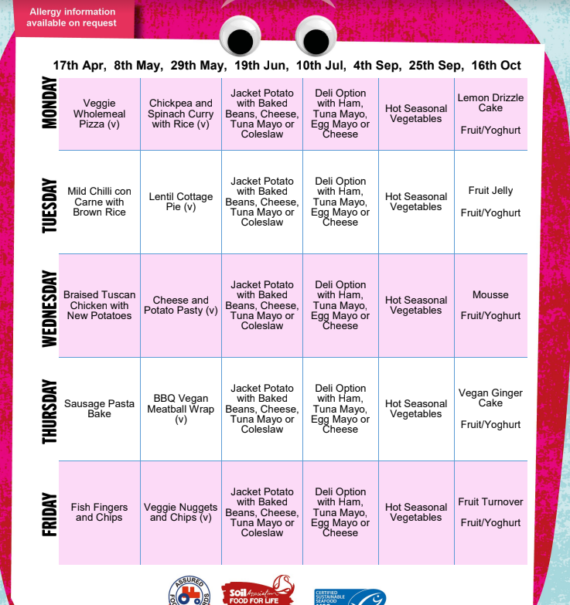
Lunch time
Hot meal or lunch box-hot meal can be ordered at a cost of £2.65
Children make choices
Healthy eating
Social
Independence

Slide 4
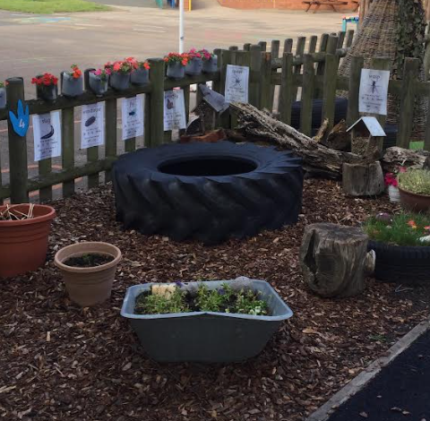
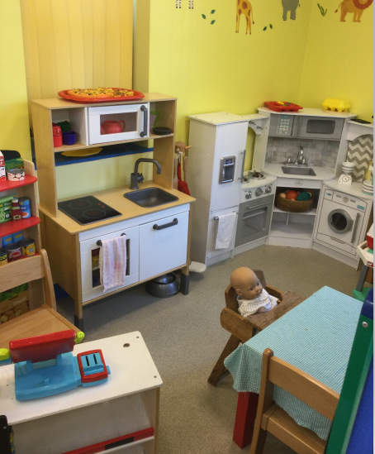
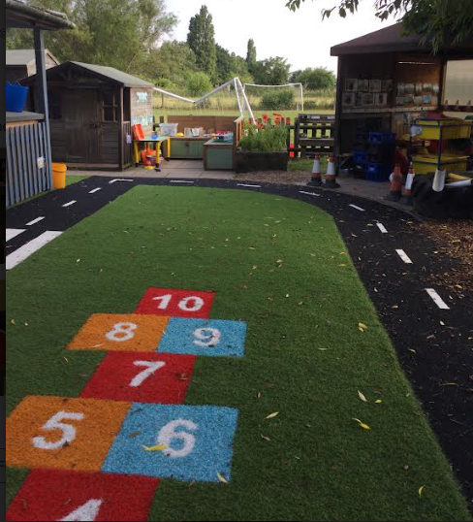
How and what do we learn in the EYFS?
Through play and experience
Inside and outside
Personalised learning
Forest school
Child-initiated learning
Adult focus opportunities

Slide 5
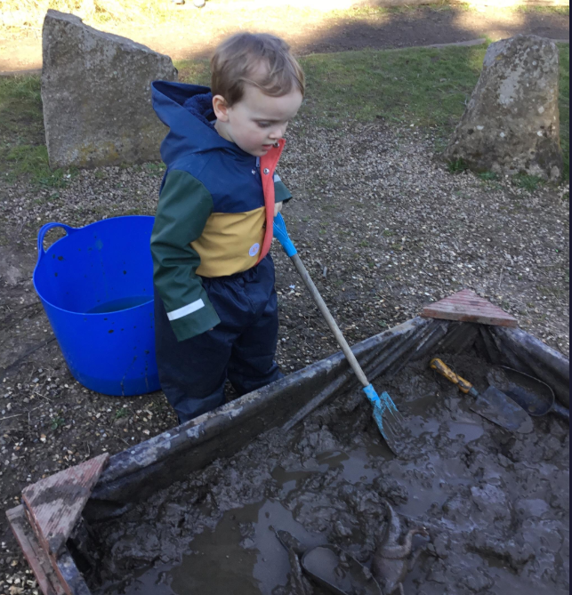
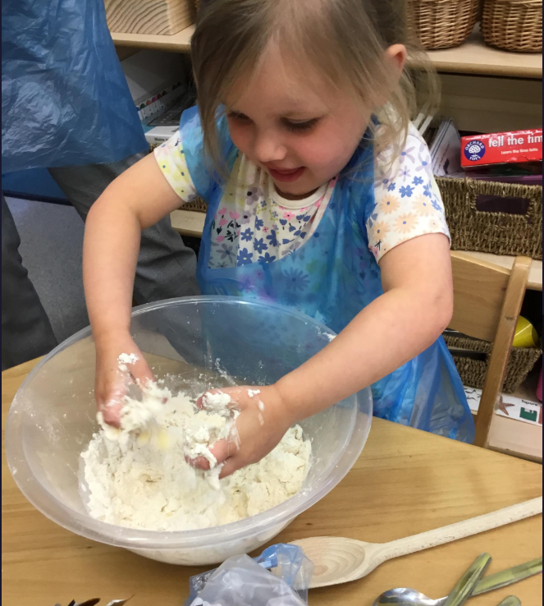
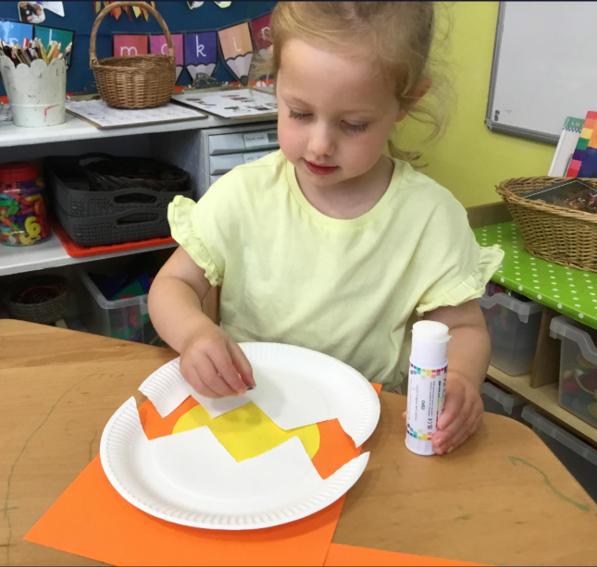
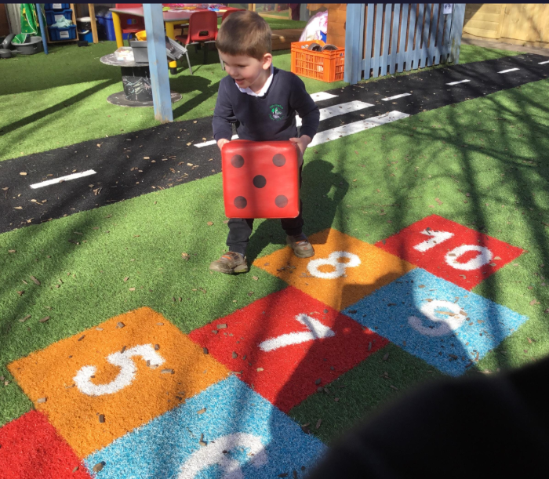
Seven Areas of Learning
PRIME AREAS
Communication and Language
Listening, Attention and Understanding
Speaking
Personal, Social and
Emotional Development
Managing Self
Self Regulation
Building Relationships
Physical Development
Gross Motor Skills
Fine Motor Skills

Slide 6
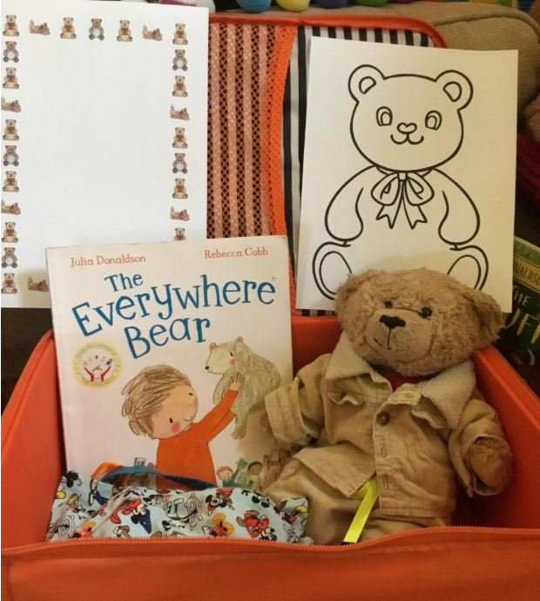
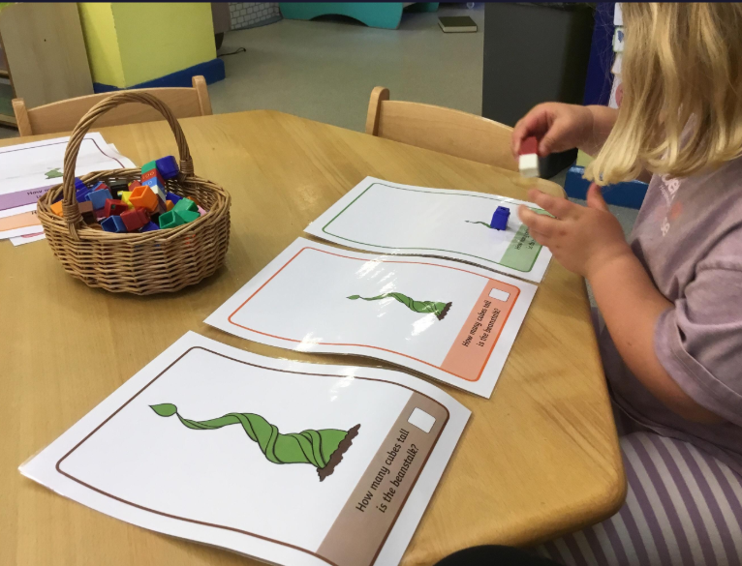
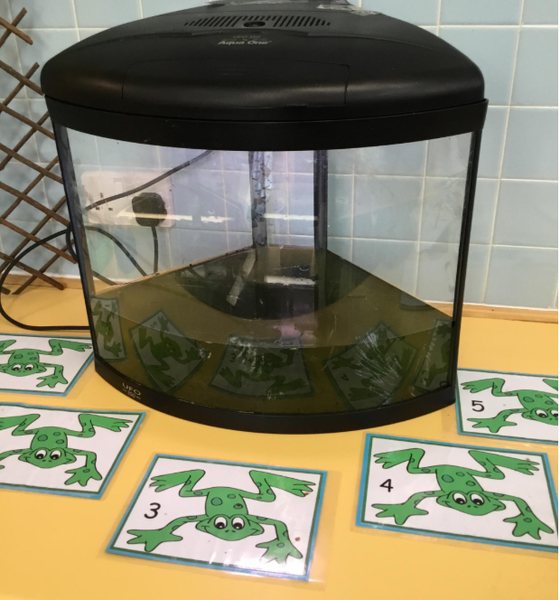
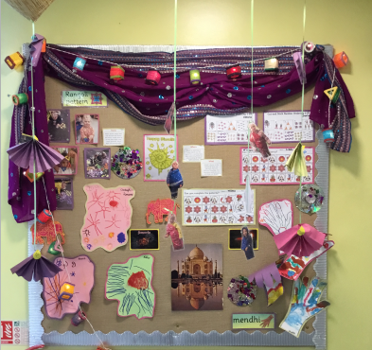
Specific Areas:
Literacy
Comprehension
Word reading
Writing
Mathematics
Number
Numerical patterns
Expressive Arts and Design
Creating with materials
Being imaginative and expressive
Understanding
the World
Past and present
People, culture
and communities
Natural world

Slide 7
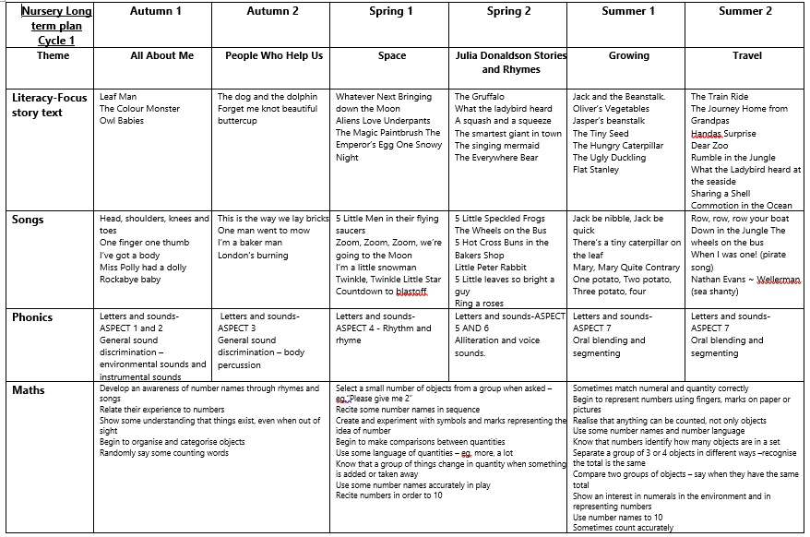

Slide 8
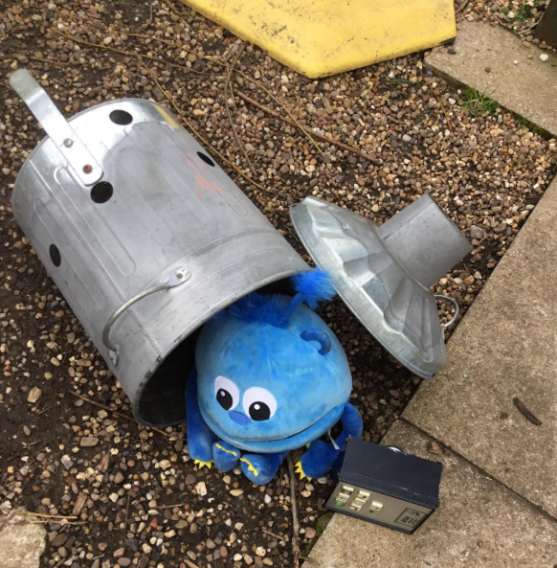
A typical day in Nursery
Arrival
Carpet time - registration/visual timetable introduce morning activities
Free flow play inside and out/focus activity/
free flow snack
Group time
Lunch time
Outside play
Carpet time - registration/visual timetable introduce afternoon activities
Free flow play inside and out/focus activity/
free flow snack
Group time
Home

Slide 9
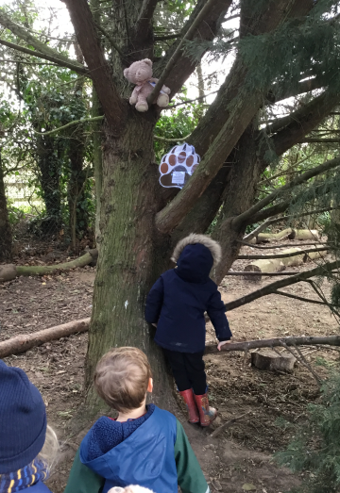
What can I expect?
Safe & secure environment
Good communication
Support
Care
Home School link

Slide 10
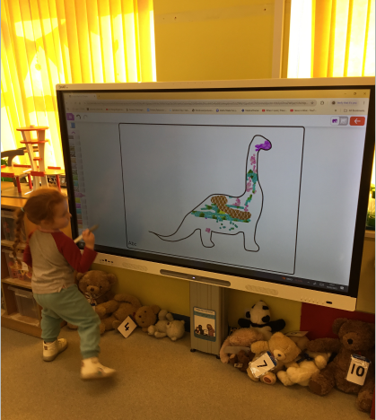
What is expected from me?
Commitment to nursery
Support children’s learning
Parents evening
Parents invited in for sessions
Work together

Slide 11
What is the PTFA?
Parent, Teachers & Friends Association (PTFA)
Every parent & carer, of a pupil at Harvington School, is automatically a member of the PTFA (so feel free to get involved)
Your PTFA is purely voluntary (we all work or have busy lives)
Our aim is to raise funds to ensure your children receive the very best education and journey through school
The PTFA lessens the financial burden on all families
The PTFA is dependant on a continual cycle of parent involvement
The PTFA needs and benefits from continuously regenerating membership with new parents

Slide 12

Want to get involved?
If you can help the PTFA support your child’s schooling,
please visit either:
www.harvingtonfirstschool.co.uk/ptfa
or

Slide 13
Nursery funding
Funding for 2 year olds
  Working families funding
  Economic circumstances
Funding for 3 and 4 year olds
  Universal funding
  Working families funding
Need to complete a funding declaration form

Slide 14
Universal funding for 3 & 4 year olds
15 hours per week x 38 weeks per year
Starts from the funding term after 3rd birthday
Funding terms start:
1st September
1st January
1st April

Slide 15
Working families funding
15 hours per week x 38 weeks per year for 2 year olds
Additional 15 hours per week x 38 weeks for 3 and 4 year olds
HMRC determine parents’ eligibility
Apply via HMRC website
www.gov.uk/apply-free-childcare-if-youre-working
If eligible, you will receive 11-digit code starting with “50” or “51”
Code MUST be valid on the first day of funding term
Code needs to be revalidated every 3 months via HMRC website

Slide 16
Other funding for 2 year olds
Some 2 year olds are eligible for 15 hours per week x 38 weeks per year
Based on economic circumstances
HMRC determine parents’ eligibility
Cannot be used alongside working families funding

Slide 17
Unfunded hours
Bills issued half-termly
Payment terms: 30 days
Payments made directly to Worcestershire County Council (NOT school)
via payment methods listed on the invoice
Can pay by HMRC tax-free childcare scheme
  Please tell us your child’s 12-character code (it will end with “TFC”) BEFORE you make a payment
  Can also be used to pay for Early Birds breakfast club and after school Wrappers club

Slide 18
Childcare vouchers
Can be used to pay fees for nursery, Early Birds breakfast club and Wrappers after school club
We are registered with most voucher schemes
Please do NOT make monthly payments
  Higher chance of payment going astray (Worcestershire County Council receive 1000’s of payments per day)
  Leave vouchers in account and pay on receipt of invoice
Please quote invoice number or customer account number on all payments - please do NOT use child’s name

Slide 19
Early Years Pupil Premium (EYPP)
Additional money to allow us to purchase extra resources to help your child
Available to children from families in receipt of certain benefits including:
  Income Support
  Income-based Jobseekers Allowance
  Income-related Employment and Support Allowance
  Child Tax Credit (providing you are not entitled to Working Tax Credit and have an annual income of no more than £16,190)
  Working Tax Credit run-on
  Universal Credit (with a net income threshold of £7,400)

Slide 20
Sharing Remarkable Learning Moments - Class Dojo
We have a main class page where we will post general information
Each child will also have their own page where we upload a remarkable learning moment each week so you can see what your child has been learning
We would also encourage you to share any achievements or adventures from home. The children love sharing their photos in school.

Slide 21


